Slide 1
Extending Multilingual BERT to Low-Resource Languages
Zihan Wang
University of California, San Diego
ziw224@ucsd.edu

Slide 2
Content
Task: Cross-lingual Zero-shot Transfer
Our method Extend
Experiments and ablation studies
Related works
Conclusion and future work

Slide 3
Limited Annotations
It is hard to obtain annotations for low resource languages.
A widely used approach is to transfer knowledge from high-resource languages (Source) to low-resource languages (LRL, Target).
Source supervision:
[Jim]_{Person} bought 300 shares of [Acme Corp.]_{Organization} in [2006]_{Time}.
Target :
ବାର୍ସେଲୋନା ଫୁଟବଲ କ୍ଲବ ବା ଫୁଟବଲ କ୍ଲବ ବାର୍ସେଲୋନା (ସ୍ପେନୀୟ ଭାଷାରେ Futbol Club Barcelona) ସ୍ପେନର ବାର୍ସେଲୋନା ସହରର ଏକ ପ୍ରସିଦ୍ଧ ଫୁଟବଲ କ୍ଲବ ।

Slide 4
Problem setup
Cross-lingual Zero-shot Transfer
Requires supervision only on Source Language.
Language adversarial training
Domain adaption
Pre-trained language models make things easy
 | Bilingual sup. | en | de | zh | es | fr | it | ja | ru | Average
Schewenk and Li (2018) | Dictionary | 92.2 | 81.2 | 74.7 | 72.5 | 72.4 | 69.4 | 67.6 | 60.8 | 73.9
Artetxe and Schwenk (2018) | Parallel text | 89.9 | 84.8 | 71.9 | 77.3 | 78.0 | 69.4 | 60.3 | 67.8 | 74.9
M-BERT | / | 94.2 | 80.2 | 76.9 | 72.6 | 72.6 | 68.9 | 56.5 | 73.7 | 74.5
[Beto, Bentz, Becas: The Surprising Cross-Lingual Effectiveness of BERT: Wu et al.’19]

Slide 5
Problem: No Language Model for LRLs
There are a lot of low resource languages in the world!
About 4,000 with a developed writing system.
Multilingual models typically cover the top-100 languages.
Model | # languages | Data source
M-BERT | 104 | Wikipedia
XLM | 100 | Wikipedia
XLM-R | 100 | Common Crawl (CCNet)
mBART | 25 | Common Crawl (CC25)
MARGE | 26 | Wikipedia or CC-News
mT5 | 101 | Common Crawl (mC4)
How to apply M-BERT to languages not pretrained on?
Use it, hope for overlapping word-pieces
Retrain a Multilingual (Bilingual) BERT
Extend M-BERT to the Target LRL.
[mT5 paper: Xue et al.’20]

Slide 6
Our Solution: Extend
Easy to obtain
Continue the pretraining task on the target language with raw text.
Accommodate for new vocabulary
Simple but effective method
Improved performance on both languages in M-BERT and out of M-BERT for cross-lingual NER.
In M-BERT: 16 languages that are in the 104 training languages of M-BERT
Out of M-BERT: 11 low resource languages that M-BERT was not trained on

Slide 7
Experiment Setting
Dataset:
NER corpus from LORELEI.
NER Model:
Bi-LSTM-CRF from AllenNLP.
Representations from language model are fixed (i.e., not finetuned)
Performance averaged over 5 runs.
BERT training:
When extending, batch size 32, learning rate 2e-5, 500k iterations.
When training from scratch, batch size 32, learning rate 1e-4, 2M iterations.

Slide 8
Languages in M-BERT
About 6% F1 increase on average for 16 languages that appears in M-BERT

Slide 9
Languages out of M-BERT
About 23% F1 increase on average for 11 languages that are out of M-BERT

Slide 11
Ablation on Extend
Performance on languages in M-BERT: 50.7 -> 56.6
Where could the improvement come from?
Additional data used for training
Additional vocabulary created
More focused training on the target language by Extend.

Slide 12
Impact of extra data
Instead of using LORELEI data to extend, we use Wikipedia data that M-BERT is trained on.
Whether using Wiki data or LORELEI data doesn’t affect the performance much.
Language | M-BERT | Extend w/ Wiki data | Extend w/ LORELEI data
Russian | 56.56 | 55.70 | 56.64
Thai | 22.46 | 40.99 | 38.35
Hindi | 48.31 | 62.72 | 62.77

Slide 13
Impact of vocabulary increase
Including extra vocabulary is important for low-resource languages (zul, uig), since there might be word-pieces that doesn’t exist in M-BERT’s vocab
Still brings improvements to in M-BERT languages: M-BERT’s vocab might not be enough.
Improvements on hin, tha and uig are significant without increase.
 | M-BERT | Increase vocab: 0 | 5,000 | 10,000 | 20,000 | 30,000 (default)
hin | 48.31 | 57.44 | 62.58 | 61.76 | 60.27 | 62.72
tha | 22.46 | 41.00 | 52.22 | 46.39 | 45.12 | 40.99
zul | 15.82 | 19.21 | 44.28 | 44.18 | 44.41 | 39.65
uig | 3.59 | 34.05 | 41.19 | 41.47 | 41.21 | 42.98

Slide 14
Extends the performance on M-BERT
On languages both out of M-BERT, and in M-BERT.
Increasing vocabulary is very useful, especially for low resource languages.
Even without expanding the vocab, improvements still exist.
Focusing on the target language is useful.
Can also train a Bilingual BERT on Source and Target.
Appropriate super-sampling and sub-sampling is applied.
Can expect that retraining costs more time.

Slide 15
Performance against Bilingual BERT
To transfer from English to a Low resource language, we can always train a Bilingual BERT on the two languages.
Low resource language | Bilingual BERT | Extended Multilingual BERT
Uyghur | 21.94 | 42.98
Amharic | 38.66 | 43.70
Zulu | 44.08 | 39.65
Somali | 51.18 | 53.63
Akan | 48.00 | 49.02
… | … | …
Average | 31.70 | 33.97
About 2% F1 increase on average for 11 low resource languages

Slide 16
Convergence speed against B-BERT

Slide 17
E-MBERT is superior to training B-BERT
In both performance and convergence
Why?
Better on Source Language (English)?
No clear advantage on understanding on English
On English NER, E-MBERT: 76.78, B-BERT: 79.60
Better on Source -> Target Learning ?
Likely true
The extra languages in M-BERT might be helping to transfer.

Slide 18
Related Work

Slide 19
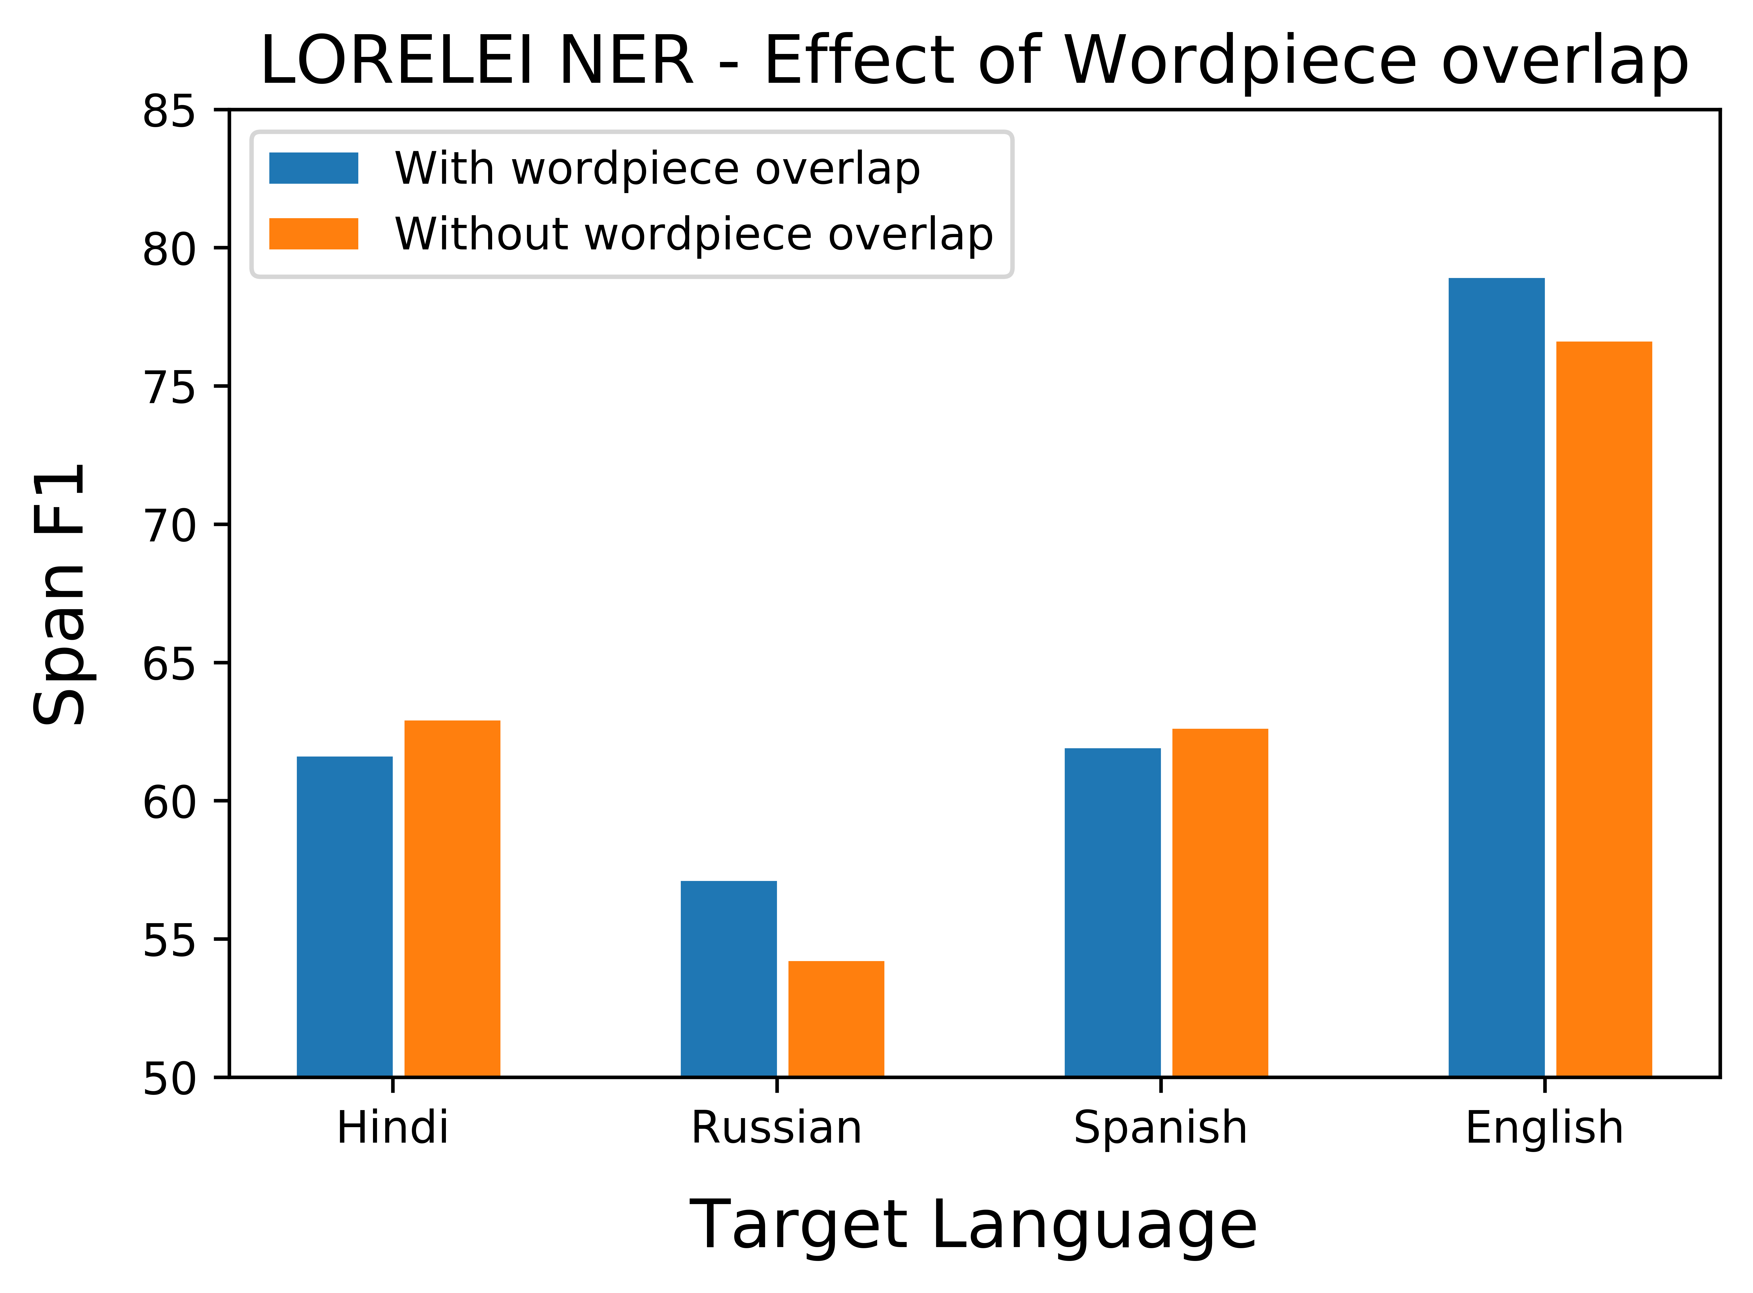
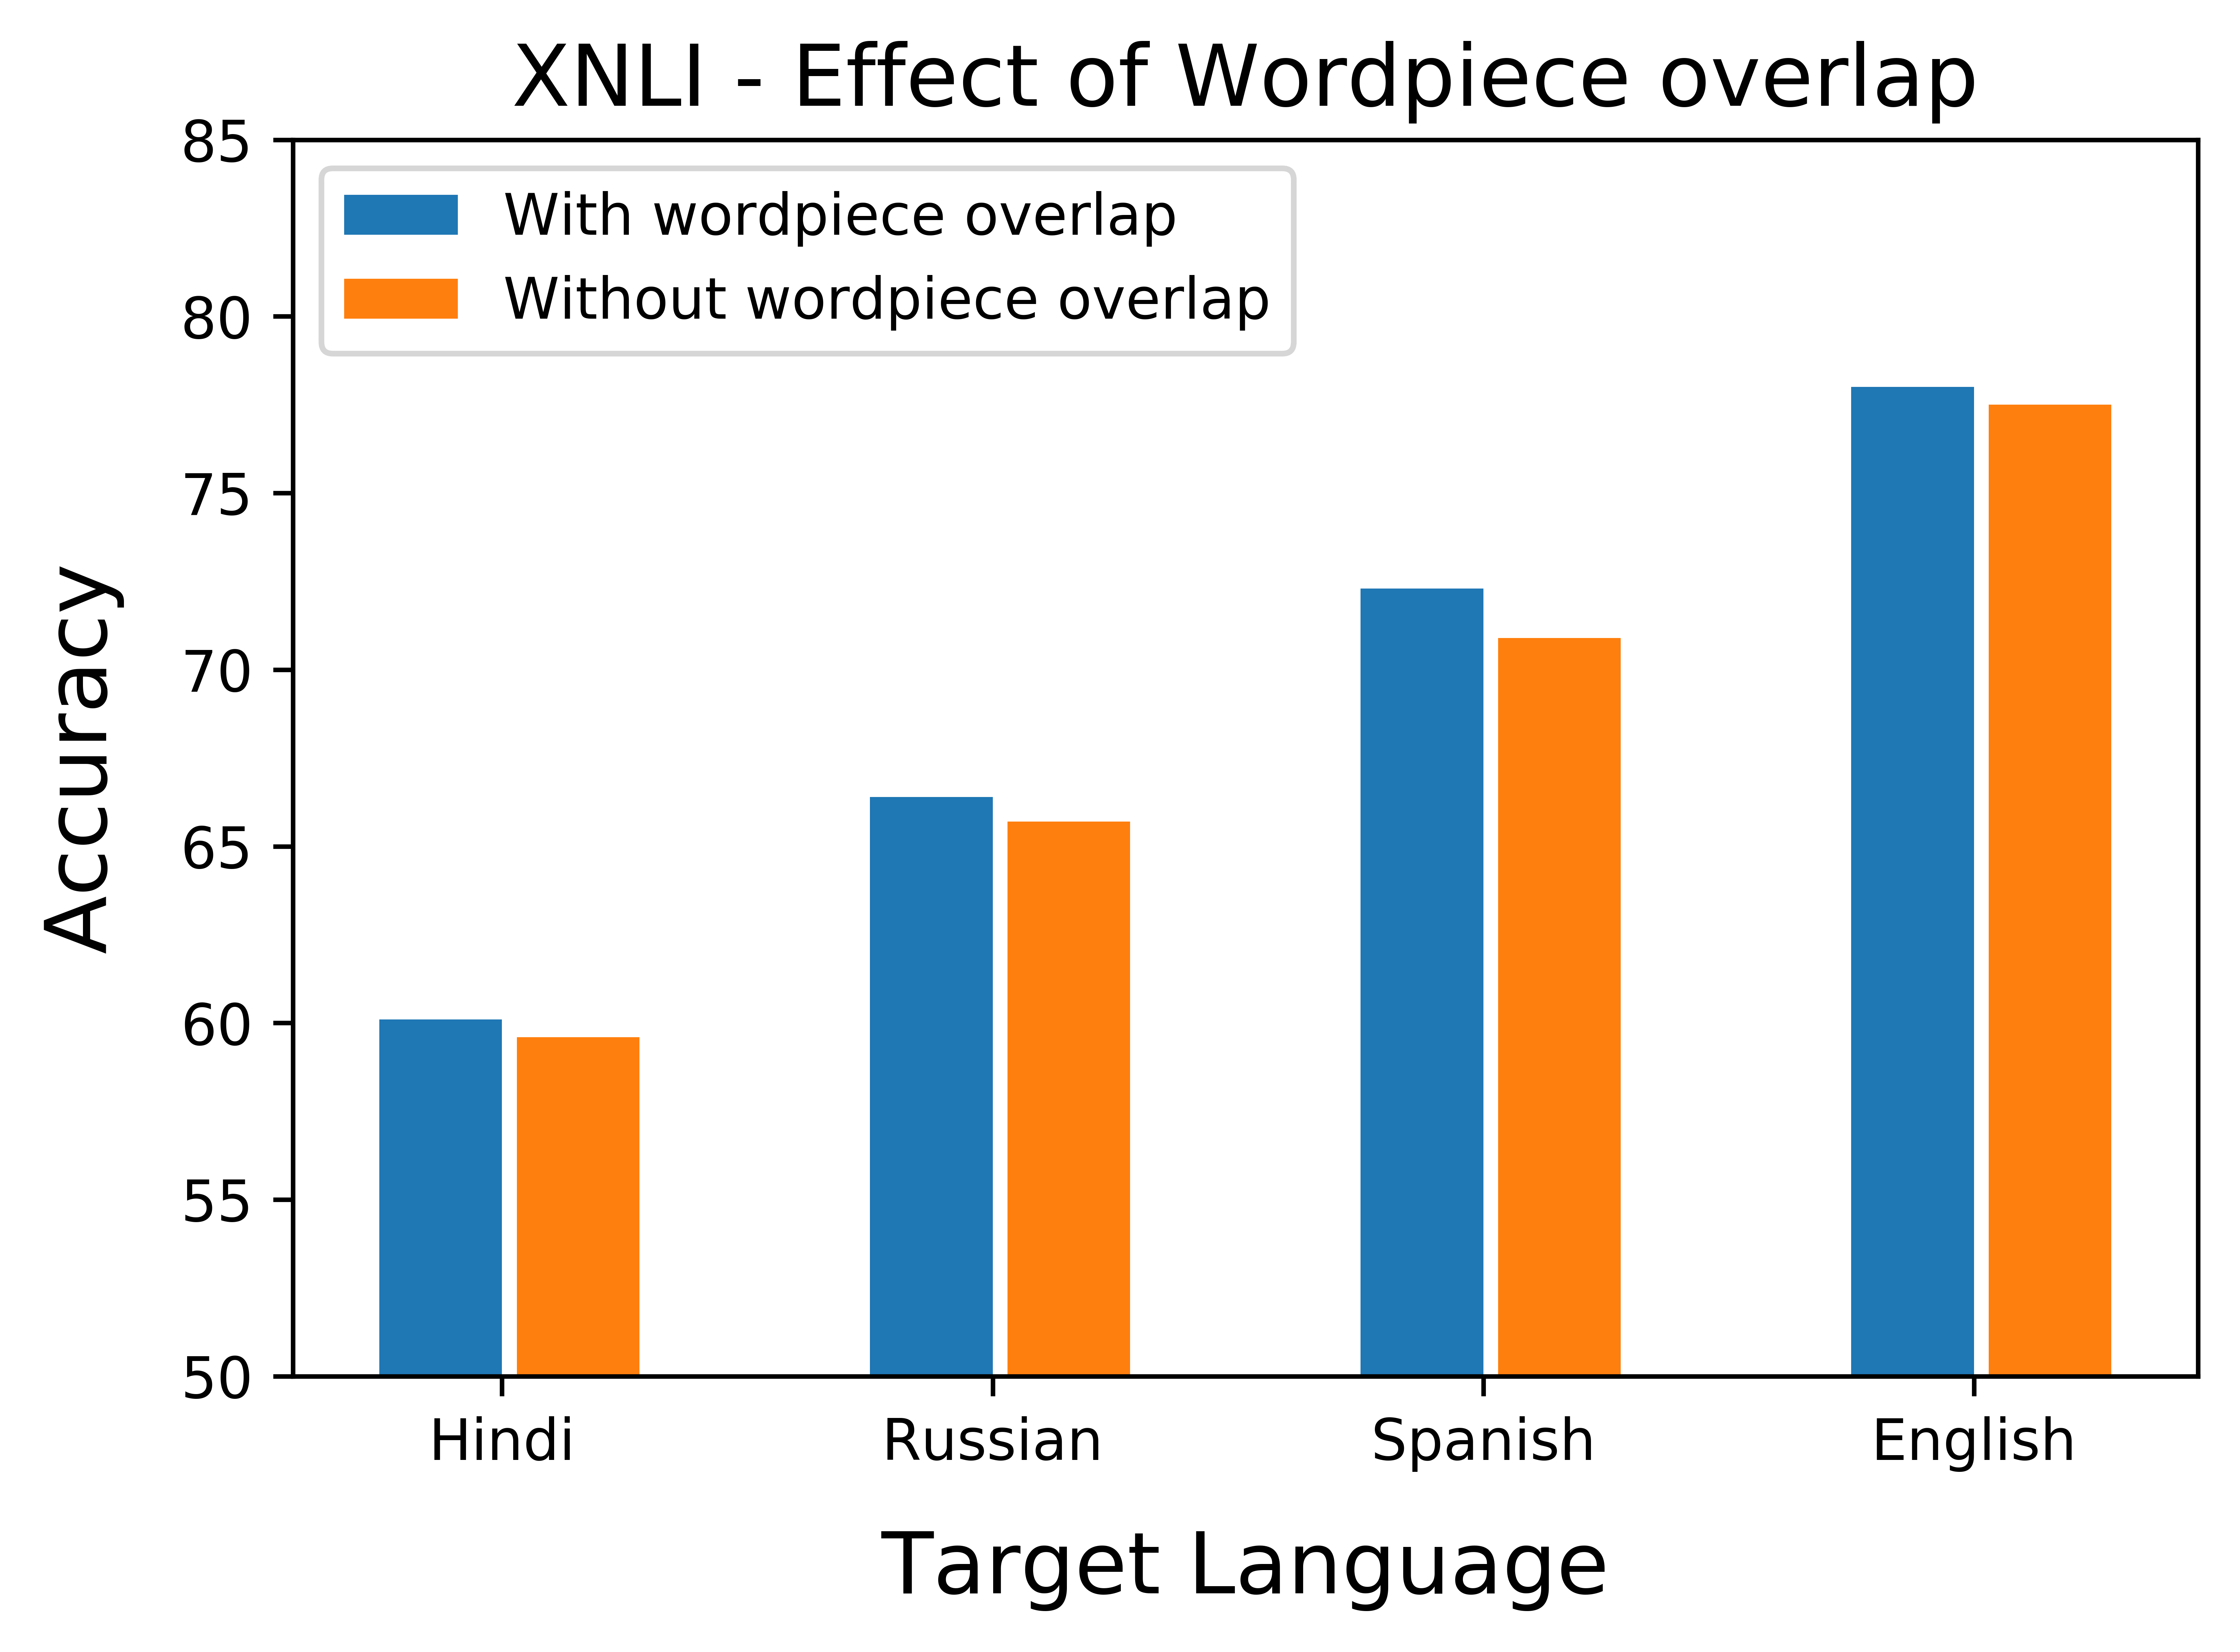
Cross-Lingual Ability of Multilingual BERT: An Empirical Study
Why multilingual BERT works?
Language similarity:
Is word-piece overlap important? No.
Is word-order important? Yes.
Is word-frequency enough? No.
Model structure:
Which is more important, depth or width? Depth.

Slide 20
X-Class: Text Classification with Extremely Weak Supervision
Using only the class name as supervision.
Estimating class-oriented representations -> Clustering -> Training.
Rivals and outperforms models that require expert given seed-words.

Slide 21
Conclusions and Future Work
Extend: a simple but effective method that can be applied on Multilingual BERT for Cross-Lingual Transfer Learning.
Improves over languages in and out of M-BERT.
Superior than training a Bilingual BERT from scratch
Cross-Lingual Ability of Multilingual BERT: An Empirical Study
Why M-BERT works?
Word-piece overlap is not the key
https://github.com/CogComp/mbert-study
X-Class: Text Classification with Extremely Weak Supervision
The class names themselves as only supervision
Representation learning -> Clustering -> Training
More careful design for vocabulary.
Account for multiple languages.
https://github.com/ZihanWangKi/XClass
https://github.com/ZihanWangKi/extend_bert
Thanks for listening. Any Questions?

