Slide 1
Cross-Lingual Ability of Multilingual BERT: An Empirical Study
Karthikeyan K, Zihan Wang, Stephen Mayhew, Dan Roth
Jan 11. 2022
Slides borrowed from Dan Roth’s talk at EMNLP’19.

Slide 2
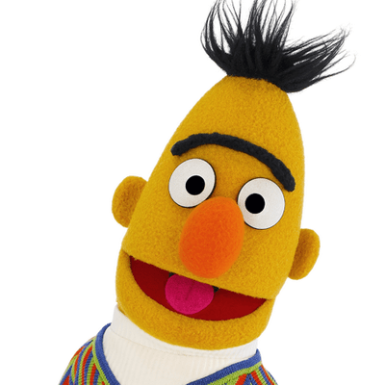
Multilingual BERT
BERT
A transformer-based pre-training language model.
Training objectives: Masked Language Modelling (MLM) and Next Sentence Prediction (NSP)
Input: A pair of sentences S1 and S2, such that half of the time S2 comes after S1 in the original text and the other half of time S2 is a randomly sampled sentence.
Data: English Wikipedia and Books corpus
Multilingual BERT (M-BERT) ?
Same training procedure as BERT except the data.
Data – Wikipedia text from top 104 languages
No specific cross-lingual objectives or any cross-lingual data.

Slide 3
Surprisingly Cross Lingual
Cross-lingual: Train on one language and test on another language
M-BERT is trained without any cross-lingual objectives but it is cross-lingual
System | English | Chinese | Spanish | German | Arabic | Urdu
XNLI Baseline - Translate | 73.7 | 67.0 | 68.8 | 66.5 | 65.8 | 56.6
BERT - Translate Train | 81.4 | 74.2 | 77.3 | 75.2 | 70.5 | 61.7
M-BERT - Transfer | 81.4 | 63.8 | 74.3 | 70.5 | 62.1 | 58.3
We can see that M-BERT transfers from English to other languages very well
[XNLI paper: Conneau et al.’18]

Slide 4
Why is M-BERT Cross-lingual?
What components of M-BERT are important for its cross-lingual ability?
We consider three dimensions:
Linguistics: What is the contribution of word-piece overlap and language similarity?
Architecture: How do depth, multi-head attention, and total number of parameters affect the cross-lingual ability of M-BERT?
Input and Learning Objective: Is Next Sentence Prediction or language identification really important? Is word or character vocabulary better than word-piece vocabulary ?
XNLI Baseline - Translate

Slide 5
Experimental Setting
Languages:
English is always the source language
3 typologically different target languages: Spanish, Hindi, and Russian
Use Wikipedia data, all four languages are sampled to the same size.
Bilingual BERT (B-BERT) – BERT trained on two languages.
B-BERT trained on language A and B is denoted as A-B
en-hi -- B-BERT trained on English (en) and Hindi (hi), similarly for Spanish (es) and Russian (ru)
Tasks:
Two conceptually different tasks: Textual Entailment and named entity recognition (NER)
TE: the XNLI dataset
Cross-lingual NER: LORELEI dataset

Slide 6
Linguistics (1): Word-piece Overlap
BERT’s representation is based on word-pieces
Hypothesis: M-BERT works due to overlapping word-pieces
M-BERT generalizes across languages because of shared word-pieces across languages that are mapped to a shared feature space.
Indeed, texts in different languages share some common word-piece vocabulary
Numbers, named entities, even actual words (when the script is shared).
We refer to this as word-piece overlap.

Slide 7
Removing word-piece overlap
To study the effect of word-pieces we should compare the models with and without it, but how to get a model without word-piece overlap?
Fake English (enfake)
Fake-English
Shifting the Unicode of each character in English Wikipedia text by a large constant so that there is strictly no character overlap with any other Wikipedia text
English and Fake-English don’t share any vocabulary/characters, but they have exactly the same structure.
We measure the contribution of word-piece overlap as the drop in performance when we use Fake-English instead of English.

Slide 8
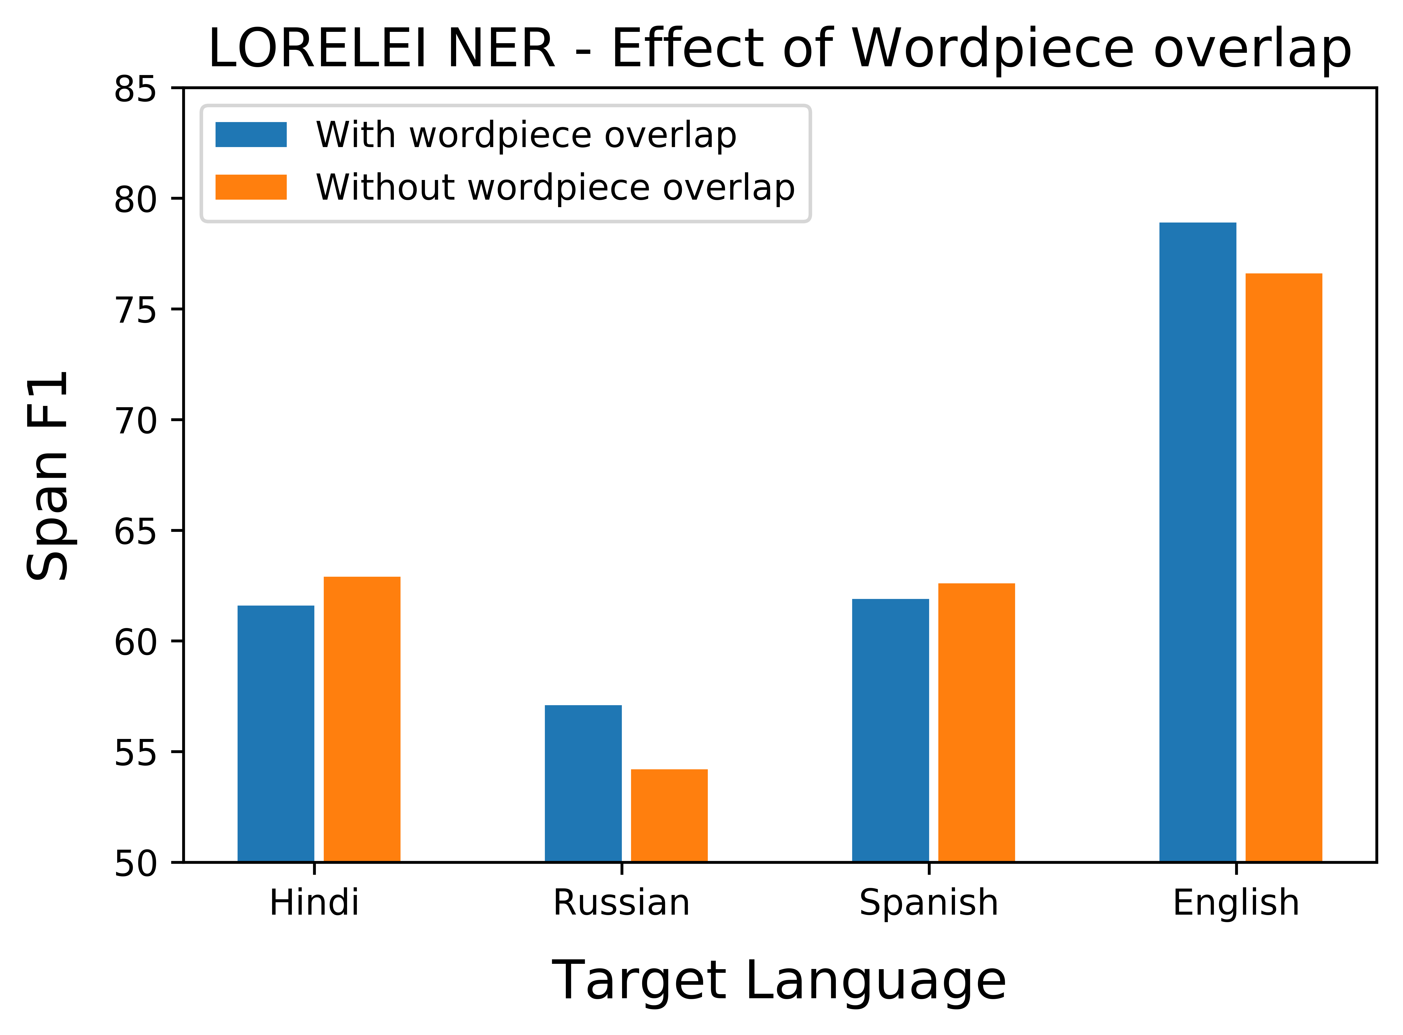
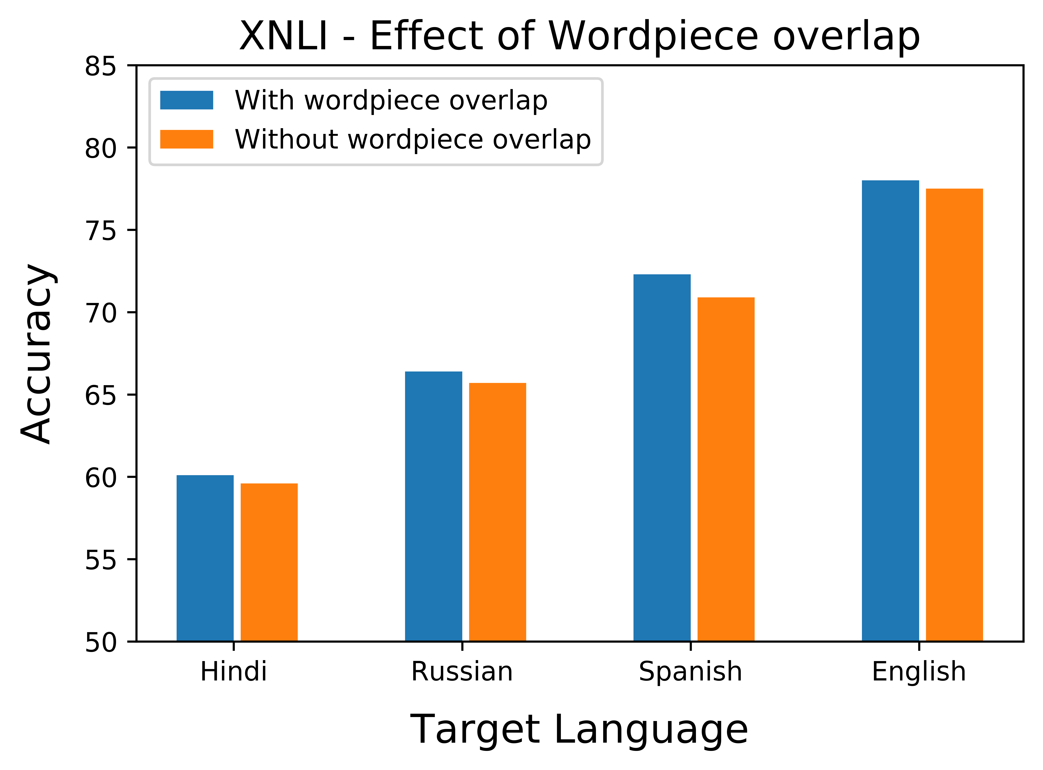
Impact of word-piece overlap
Setting:
Train a pair of B-BERTs
English-L vs. FakeEnglish-L
Tune on English (FakeEnglish, resp.) data
Test on the target Language
(Right most: Eng-FakeEnglish B-BERT; tune on FakeEnglish; test on both)
B-BERT is cross-lingual even when there is absolutely no word-piece overlap

Slide 9
Linguistics (2): Structural Similarity
Structure of a language
In today’s context, we define “structure” to include every aspect of the language that is invariant to its script.
E.g., morphology, word-ordering, word frequency, word-pair frequency, etc.
Note that English and Fake-English do not share any vocabulary or characters
but they have exactly the same structure
Intuitively, English and Spanish are more “structurally similar” than (English, Hindi) and (English, Russian).
Hypothesis: There is some similarity on ordering of words in each language
Hypothesis: Bert can rely on similarity of frequency of words to learn cross-lingually.

Slide 10
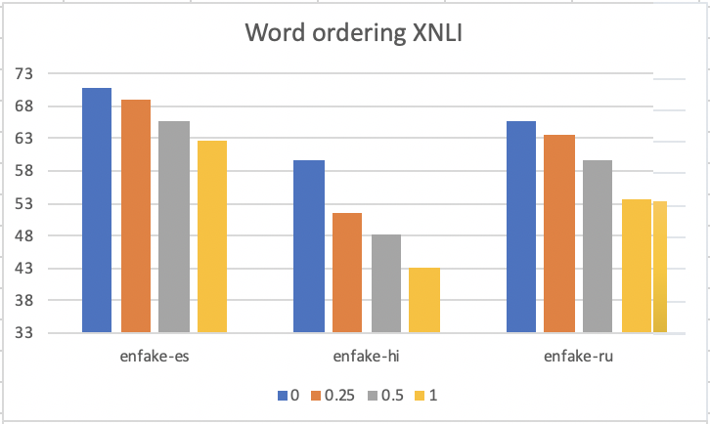
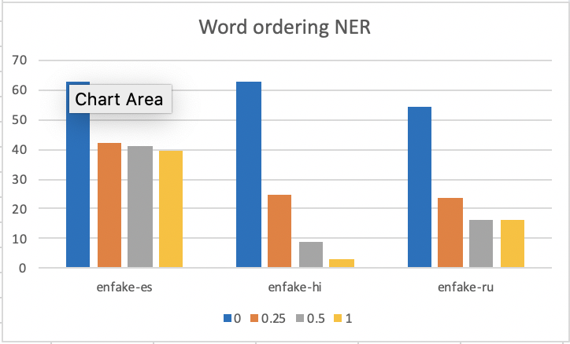
Eliminating word ordering
We eliminate similarity of word ordering on a pair of languages (e.g. Fake English-Spanish) by randomly permuting each sentence.
Permuting: for a sentence of length $L$, we define permuting it with probability $p$ as randomly choosing $p\left({L \atop 2}\right)$ pairs of indices from all $\left({L \atop 2}\right)$ indices and swap them.
Finetune on un-permuted Fake English
Ordering is a main source of similarity, but there is still something beyond. BERT performs better than random when there is no order --- when the set of context words are the same.
Notes:
The permutation defined above does not generate a perfectly uniform distribution on all permutations (e.g. even/odd permutations can only be generated by even/odd number of swaps), But it provides a good way to control how “random” we want to generate.

Slide 11
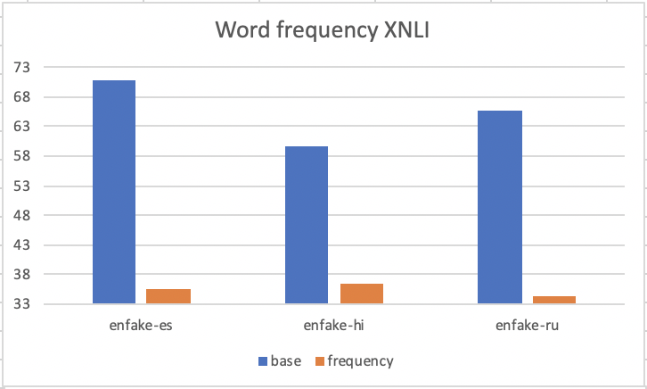
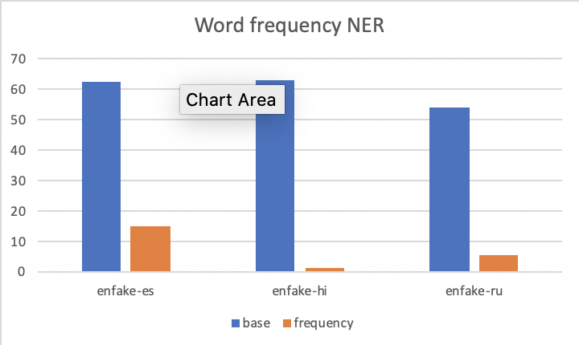
Preserving unigram word frequency
By re-generating the pre-training text corpus based on distribution of vocabulary in the language, we can generate a frequency-based corpus such that BERT can only learn from similar frequencies between two languages --- when no context within sentence is preserved
BERT learns almost nothing with unigram frequency.
Hypothesis: BERT can learn cross-lingual features with k-co-occurrences (k > 1) of words.

Slide 12
The Impact of Structural Similarity
The same setting:
Train a pair of B-BERTs
English-L vs. FakeEnglish-L
Tune on the English (or FakeEnglish) data
Test on the target Language
Fake-English transfers to English almost perfectly.
And transfers to other languages as English does.
Quality of transfer:
(English, Hindi) < (English, Russian) < (English, Spanish) < (English, FakeEnglish)
In all pairs: no word-piece overlap
The transferability is due to the structural similarity between language L and (Fake)-English.
Leaves more questions on the specific aspects of structural similarity that matters.

Slide 13
The Impact of Structural Similarity
B-BERT | Train | Test | XNLI
 |  |  | Accuracy
en-es | en | es | 72.3
enfake-es | enfake |  | 70.9
en-hi | en | hi | 60.1
enfake-hi | enfake |  | 59.6
en-ru | en | ru | 66.4
enfake-ru | enfake |  | 65.7
en-enfake | enfake | enfake | 78.0
en-enfake | enfake | en | 77.5
The same setting:
Train a pair of B-BERTs
Tune on the English (or FakeENglish) data
Test on the target Language
Fake-English transfers to English almost perfectly.
And transfers to other languages as English does.
Quality of transfer:
(English, Hindi) < (English, Russian) < (English, Spanish) < (English, FakeEnglish)
In all pairs: no word-piece overlap
The transfer ability is due to the structural similarity between Spanish and (Fake)-English.
Leaves more questions on the specific aspects of structural similarity that matters.

Slide 14
Architecture
Here we study:
The depth of the Transformer structure
Number of attention heads
Total number of parameters

Slide 15
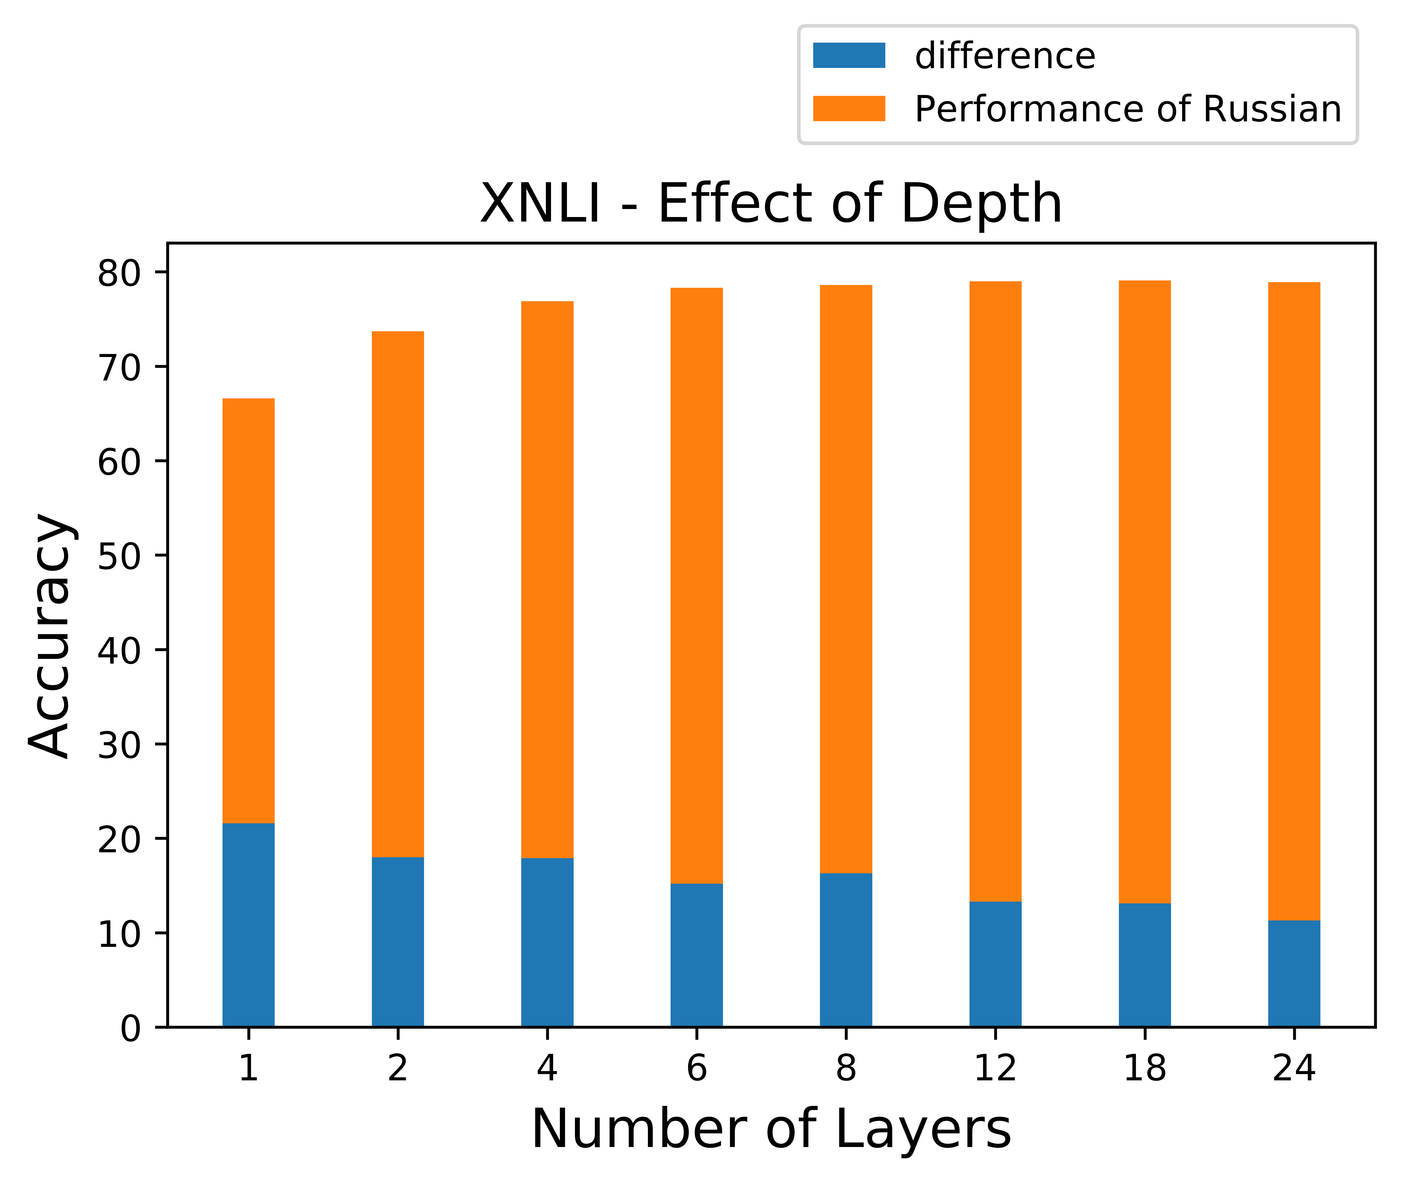
Architecture (1): Depth is critical
We vary depth
Fix #(attention heads)
Fix #(parameters)
the size of the hidden and intermediate units is changed so that the total number of parameters remains almost the same
Measure cross-lingual transfer as the difference between the performance on Fake-English and vs. performance on Russian.
Similar results in other languages.
Deeper models (1) perform better and (2) transfer better.

Slide 16
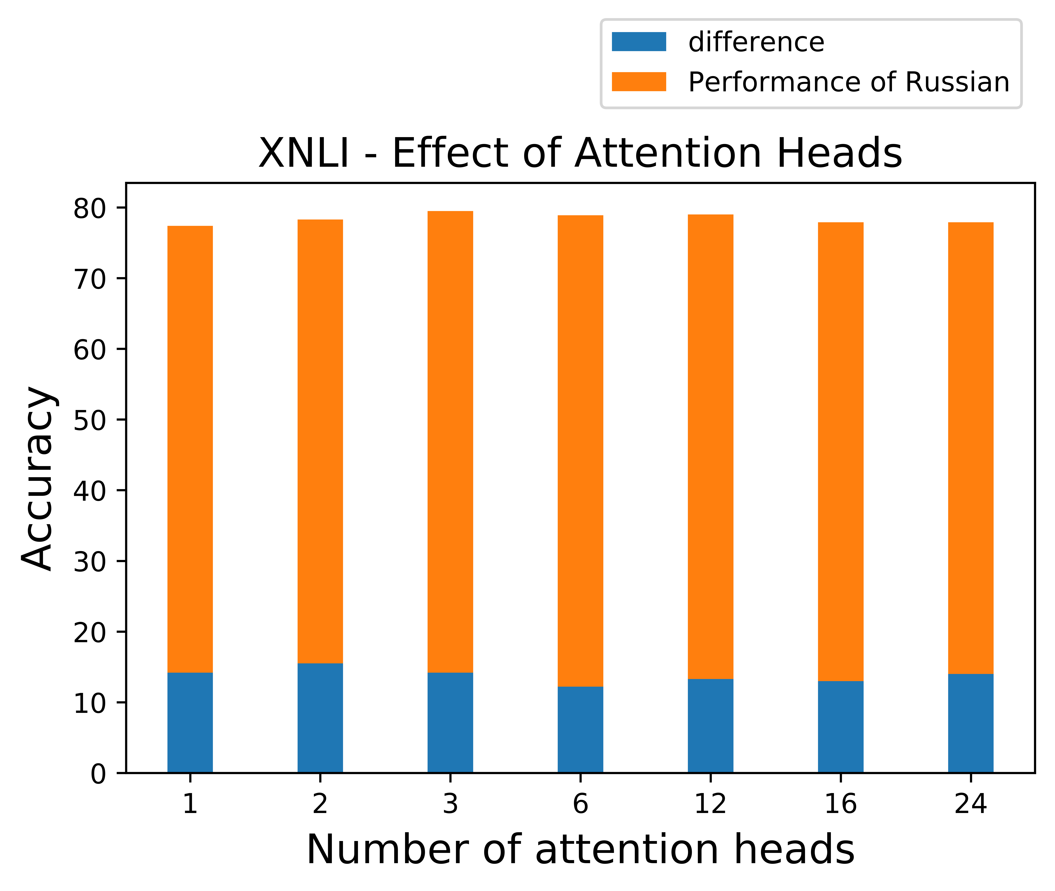
Architecture (2) #(Attention Heads)
We vary #(attention heads)
Fix Depth
Fix #(parameters)
Measure cross-lingual transfer as the difference between the performance on Fake-English and vs. performance on Russian.
Similar results in other languages.
B-BERT ability to transfer exists even with a single attention head

Slide 17
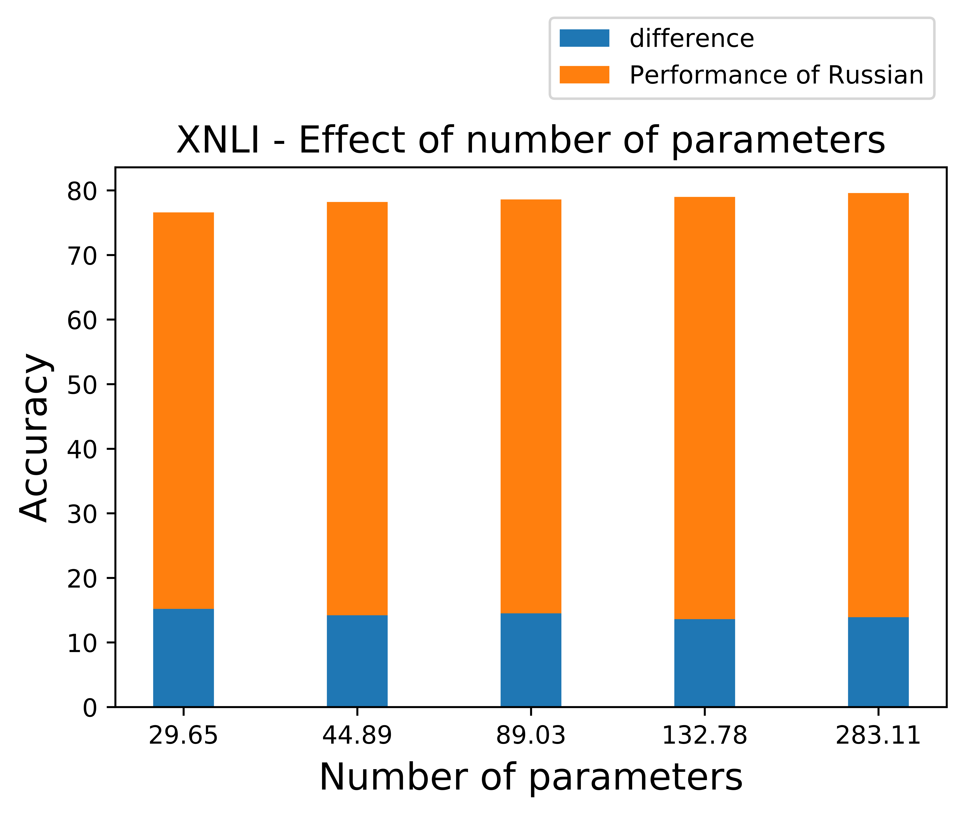
Architecture (3) #(Parameters)
We vary #(parameters)
by changing size of hidden and intermediate units
Fix #(attention heads)
Fix Depth
Measure cross-lingual transfer as the difference between the performance on Fake-English and vs. performance on Russian.
Similar results in other languages.
The #(parameters) isn’t as significant as depth
But, below some threshold, #(parameters) seems significant (not shown)

Slide 18
Architecture (3) #(Parameters)
We vary #(parameters)
by changing size of hidden and intermediate units
Fix #(attention heads)
Fix Depth
The #(parameters) isn’t as significant as depth
But, below some threshold, #(parameters) seems significant
Parameters (M) | Depth | Multi-head Attn | XNLI
 |  |  | Fake-English | Russian | Gap
7.87 | 3 | 3 | 0.685 | 0.432 | 0.253
12.19 | 3 | 3 | 0.701 | 0.441 | 0.260
16.78 | 3 | 3 | 0.708 | 0.504 | 0.204
8.40 | 6 | 6 | 0.702 | 0.497 | 0.205
13.37 | 6 | 6 | 0.724 | 0.562 | 0.162
18.87 | 6 | 6 | 0.733 | 0.544 | 0.189
29.65 | 12 | 12 | 0.766 | 0.614 | 0.152
44.89 | 12 | 12 | 0.782 | 0.640 | 0.142
89.03 | 12 | 12 | 0.786 | 0.641 | 0.145
283.11 | 12 | 12 | 0.796 | 0.654 | 0.142
132.78 | 12 | 12 | 0.790 | 0.657 | 0.133

Slide 19
Input and Learning Objective
Does Next Sentence Prediction affect cross-lingual ability ?
Yes, it hurts performance. Even more than in the monolingual case.
Can we include Language Identity in the input to B-BERT ?
Adding language identify markers to the input does not make a difference.
What is the impact of token representation (Character vs Word-piece vs Word)?
word-piece tokenized input is better than both
It seems to carry more information than characters, and address unseen words better than words.

Slide 20
Conclusions
Language similarity:
Is word-piece overlap important? No.
Is word-order important? Yes, but even bag-of-words can transfer.
Is word-frequency enough? No.
Model structure:
Which is more important, depth or width? Depth.
Input representations:
Language Identity Markers have little affect on the transferability.

